Slide 1
Cooperation to create innovation and sustainability​
Notes:
InnoCities - basic slides for the presentation of the concept, e.g. for decision-makers Ecosystems innovation policy sustainable urban development need-cost-benefit -problems and solutions in the cities -contribution of only 25%! -benefit: the city can set its agenda, highlight its important matters, partnership with TEM and 15 other cities -The EUR 150 million of the InnoCities isn’t included in R&D funds.

Slide 2
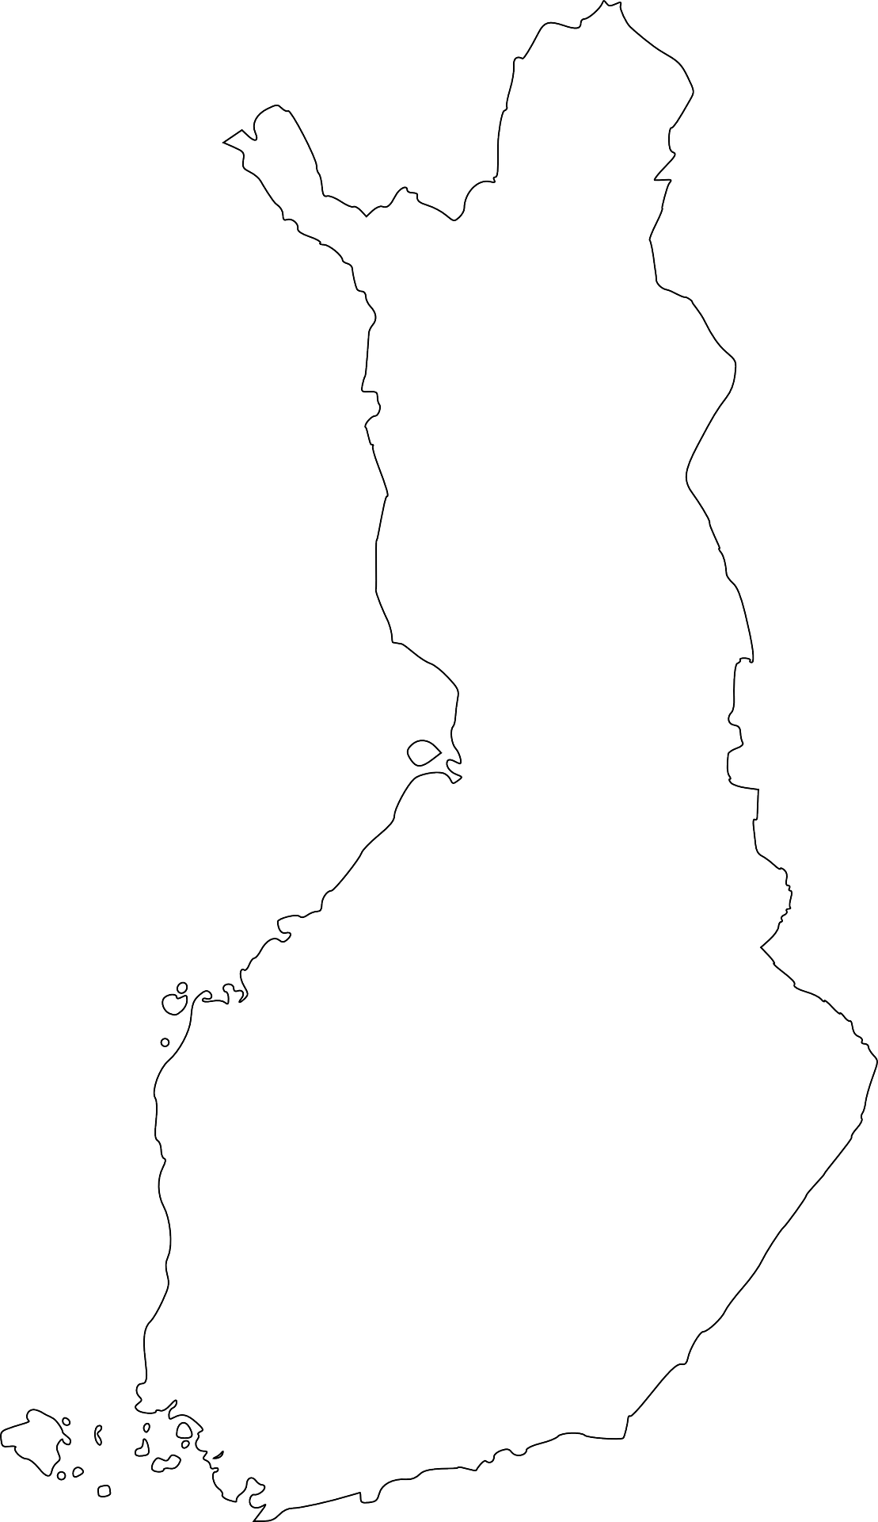
Cities with ecosystem agreements
Espoo, Helsinki and Vantaa
Joensuu
Jyväskylä
Kokkola
Kuopio
Lahti
Lappeenranta (+Imatra)
Mikkeli
Oulu
Pori
Kajaani (+Sotkamo)
Rovaniemi
Seinäjoki
Tampere
Turku
Vaasa

Slide 3
Why are InnoCities created?
EU’s sustainable urban development
Ecosystem agreement
RDI investments and cooperation
Cities are the platforms of European innovation operations. Simultaneously, different sustainability challenges are identified and need to be solved in cities.
InnoCities are a Finnish way of implementing the EU’s sustainable urban development, with green and digital transitions at its core.
The agreement of the city and the Ministry of Economic Affairs and Employment on the development of the selected ecosystems.
Includes 16 important development areas of Finnish RDI activities: university and university consortium cities.
The target, 4% of RDI investments, requires us to improve the conditions for growth, including the development environments and the innovation capacity of the regions.
By investing in innovation, cities support higher education institutions and businesses and create the conditions for the growth of productivity and vitality in their regions.

Slide 4
Sustainable transition
Themes
Digitalisation and new technologies
Wellbeing
Actions
Development environments and experiments
Development of the start-up ecosystem
Investment areas, planning and public procurement
Demonstrations promoting energy efficiency and circular economy
Attracting the international experts and their availability
Accelerating the digital investments of businesses

Slide 5
Co-funding for greater investment
Between 2021 and 2027, the EU, the state, cities and other public actors are investing nearly EUR 200 million in the development of innovation ecosystems.
Cities participate in this with a share of 25–40%.
As of October 2024, there are ongoing projects worth EUR 62 million, with cities investing EUR 17 million in total. Each city’s direct funding share varies from EUR 0.5 million to EUR 2.5 million.
EU and the state ERDF funding is managed by Regional Councils in cooperation with cities.
Notes:
What type of projects are there? Action.

Slide 6
Benefits for the cities
Commitment of the operators in the area to common goals.
State funding for own development projects of the cities.
Long-term investment in RDI and green and digital transitions
National and international cooperation in lead projects
Instrument for new openings
Viable companies, strengthened skills and new solutions
Notes:
Setting goals and direction
Cities are supported in strengthening their vitality and implementing the green and digital transitions.
By smart action, it’s also possible to combine other financial instruments for the development of the city’s key ecosystems

Slide 7
A few examples of the goals of the projects currently in progress:
337
1510
579
platforms and networks participating in supporting joint development
companies participating in joint development
innovations, products or services

Slide 8
InnoCities are currently being created by 18 cities, 79 organisations, 252 projects and 14 Regional Councils.
Learn more: Innokaupungit.fi/en/innokaupungit/

Slide 9
Together, we are making Finland the most innovative country in the world.

